Slide 1
Orientable and oriented
An oriented surface is an orientable surface together with a fixed continuous unit normal field on it.
For orientable surface, such normal field exists, but does not have to be chosen and fixed.

Slide 2
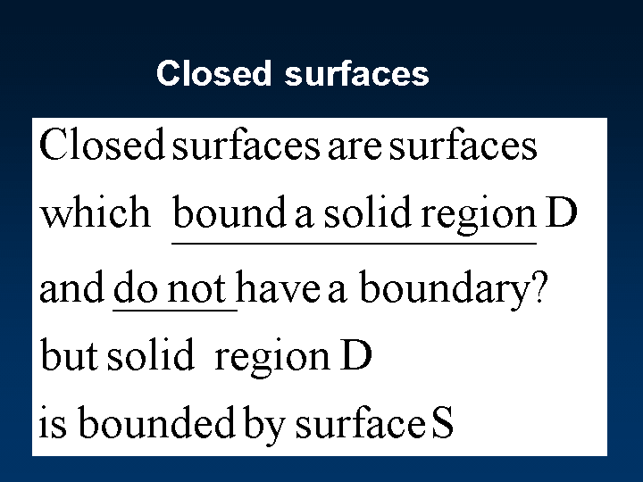

Slide 3
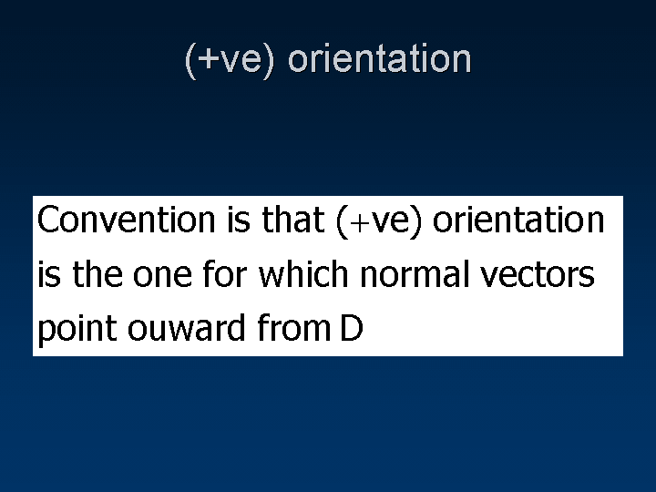

Slide 4
Open vs closed surfaces
Surfaces which don’t enclose a bounded solid completely are open surfaces.
Boundary of a open surface is a curve which is its cliff (you may fall off the surface if you cross it.)

Slide 5
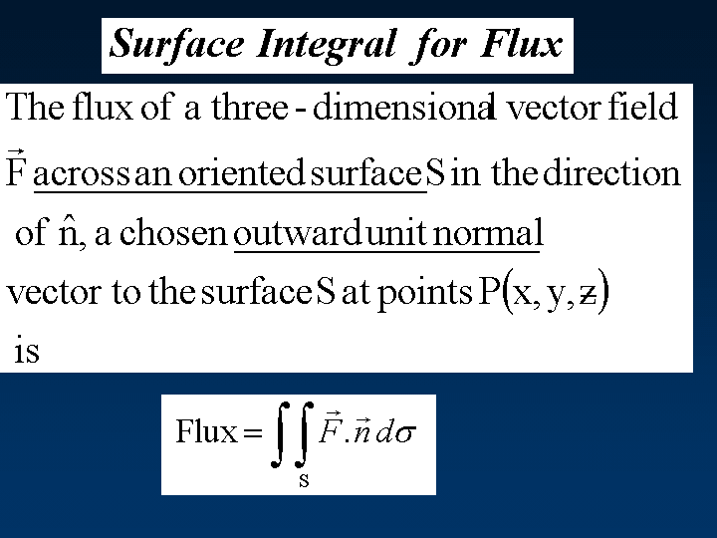
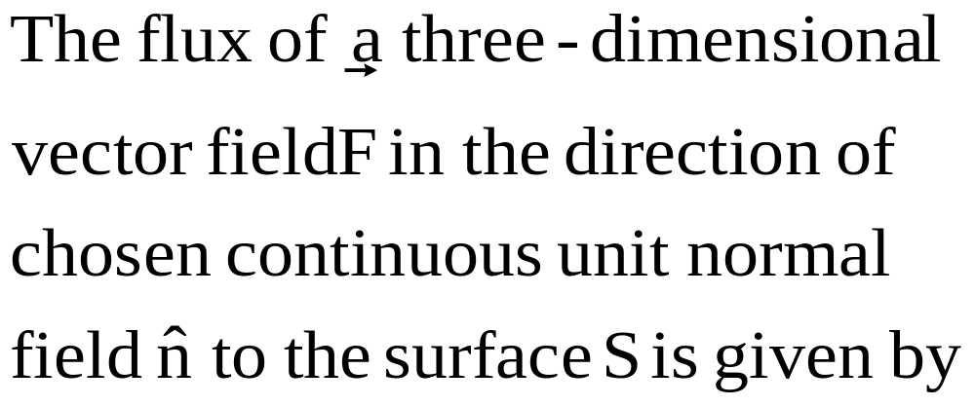

Slide 6
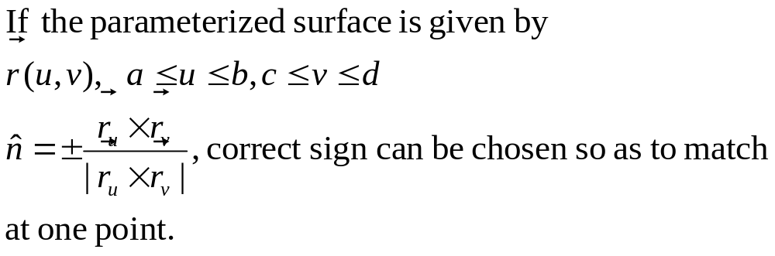
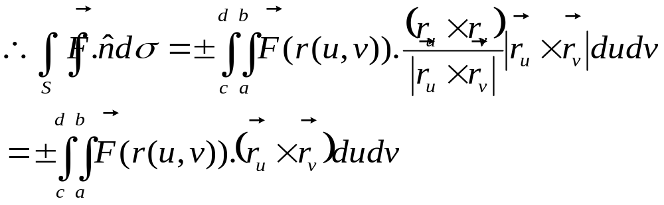
The surface integral can be evaluated using either
level surface or parameterized surface method.

Slide 7
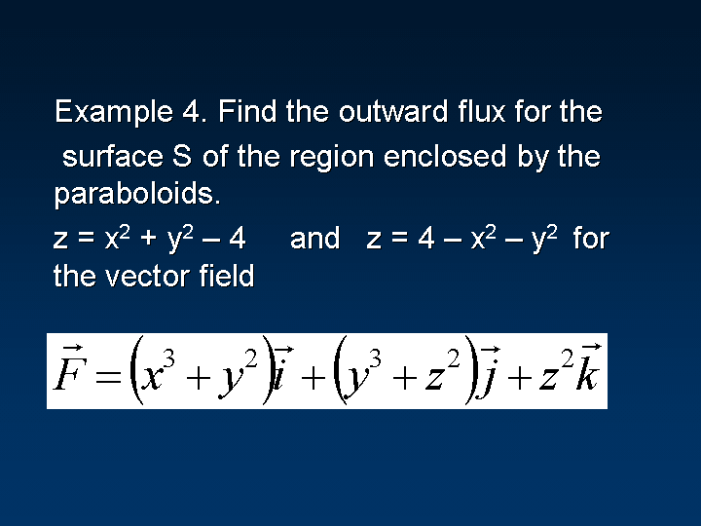

Slide 8
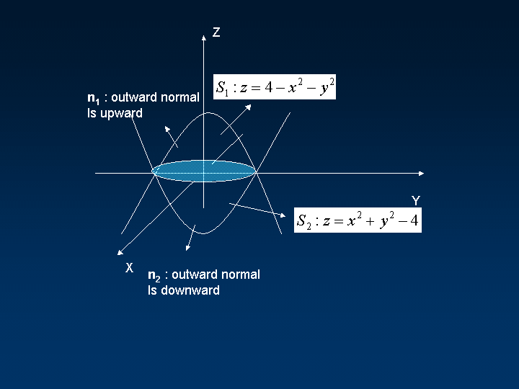

Slide 9
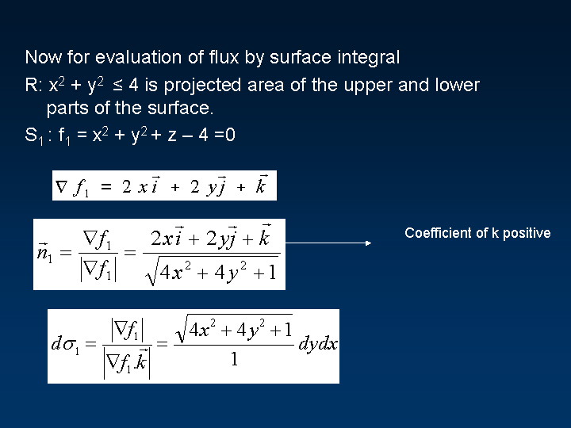
As normal points upwards

Slide 10
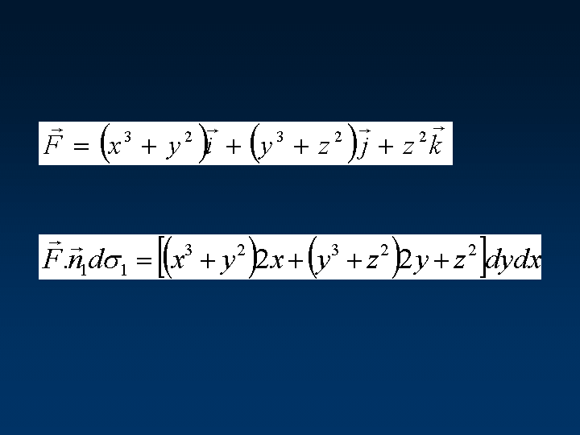

Slide 11
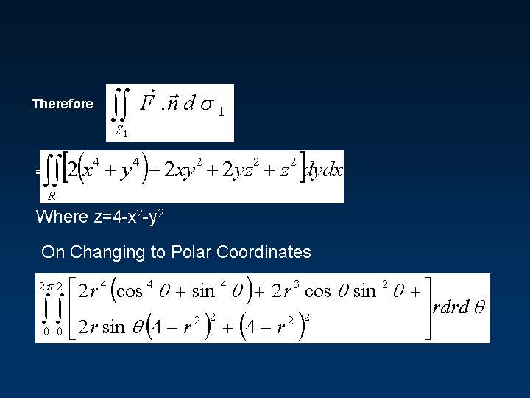

Slide 12
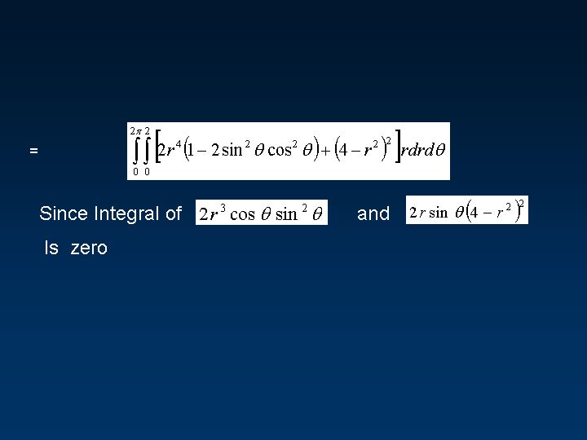

Slide 13
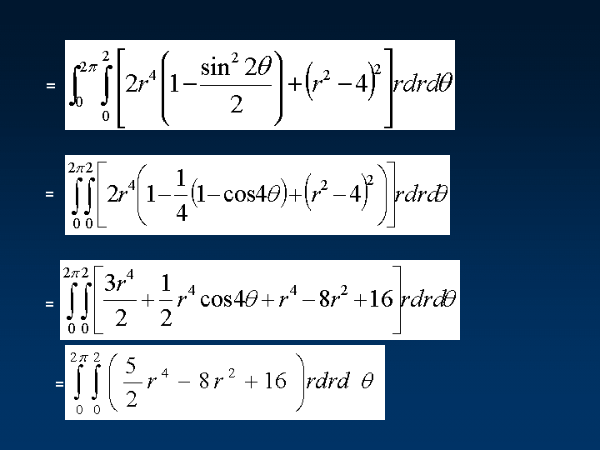

Slide 14
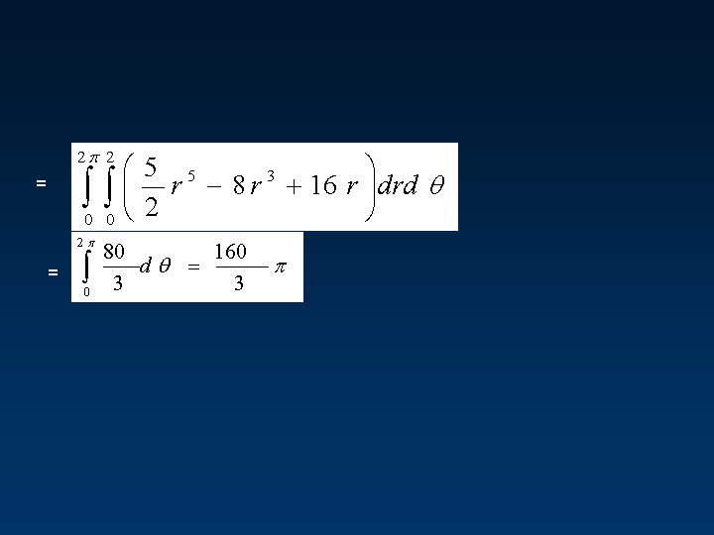

Slide 15
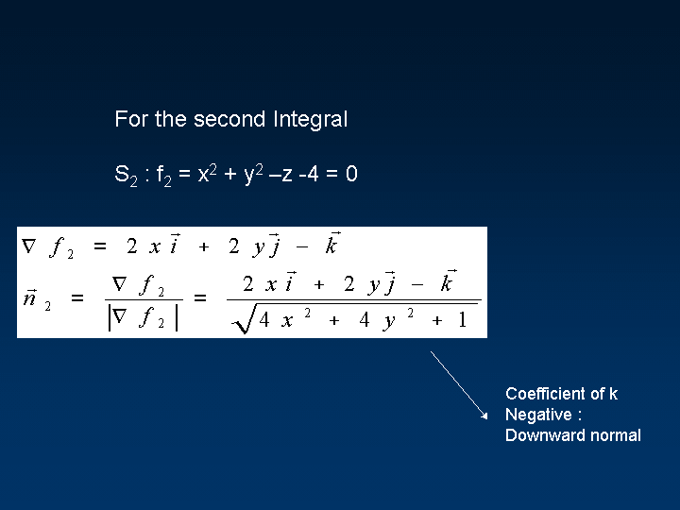

Slide 16
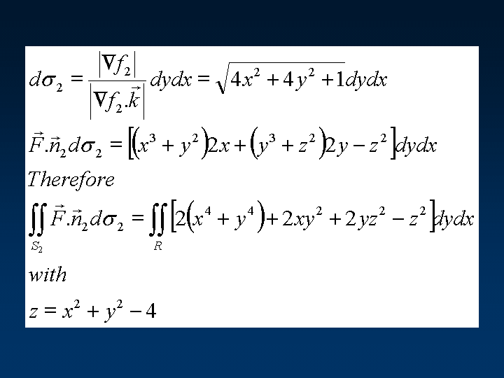

Slide 17
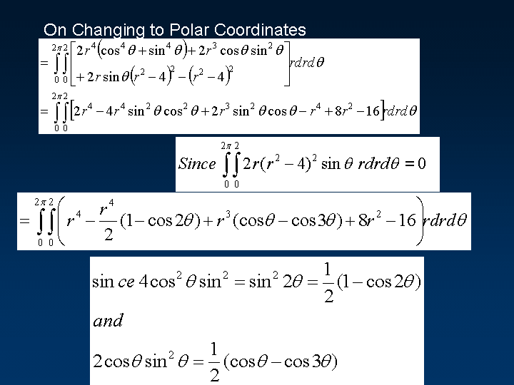

Slide 18
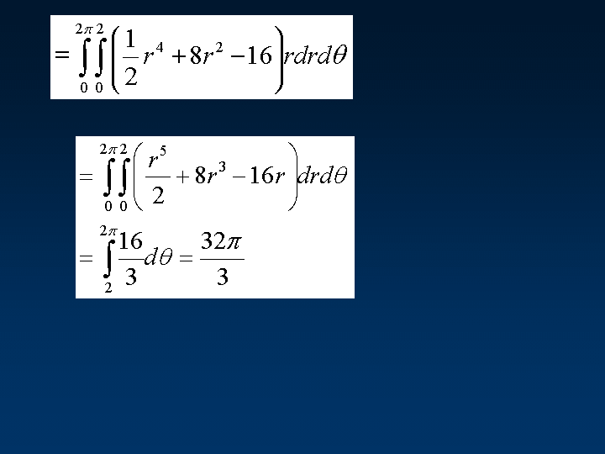

Slide 19
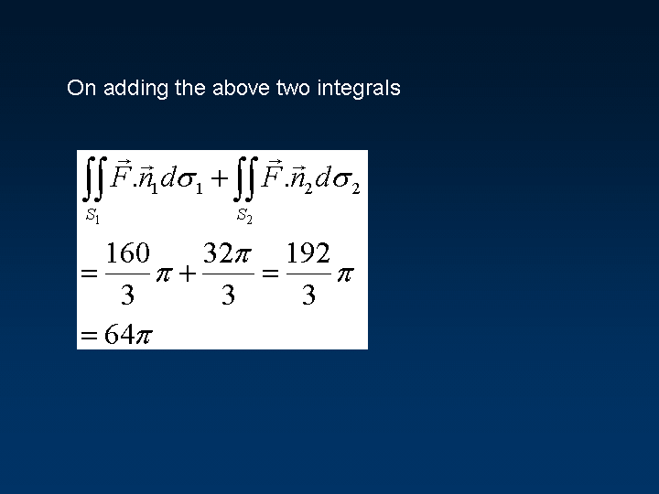

Slide 20
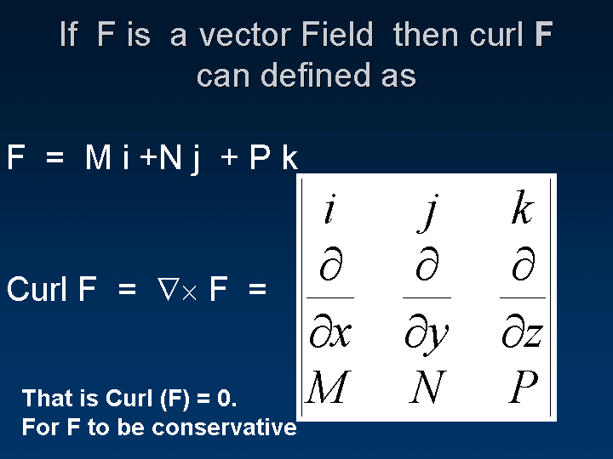

Slide 21
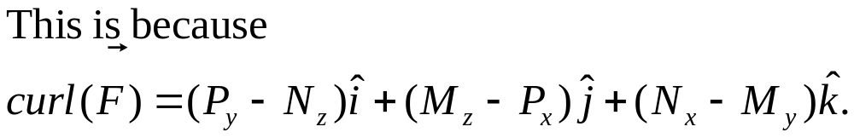

Slide 22
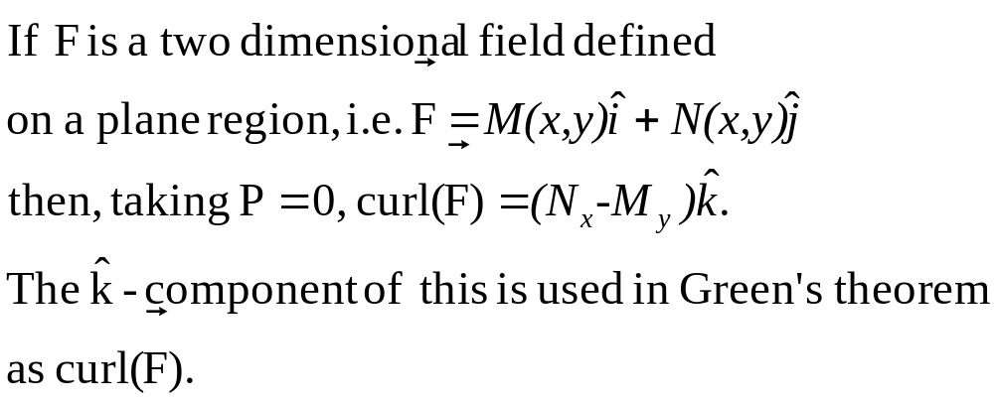

Slide 23
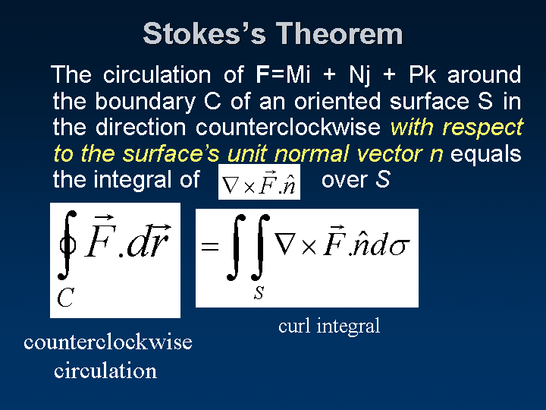

Slide 24
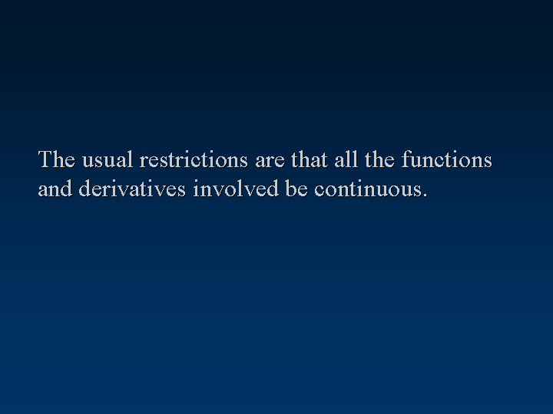

Slide 25
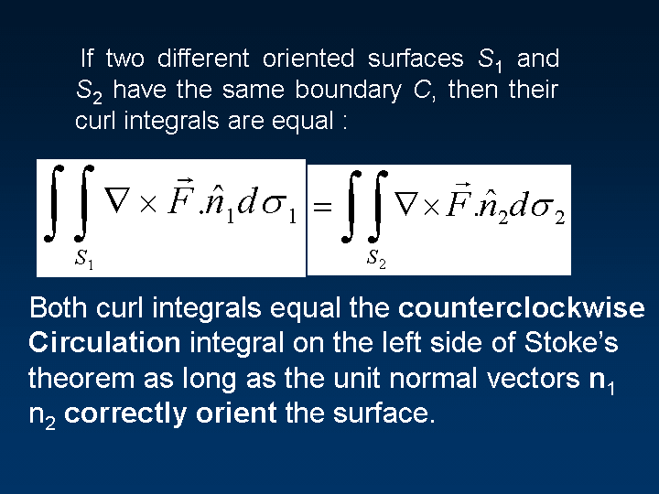

Slide 26
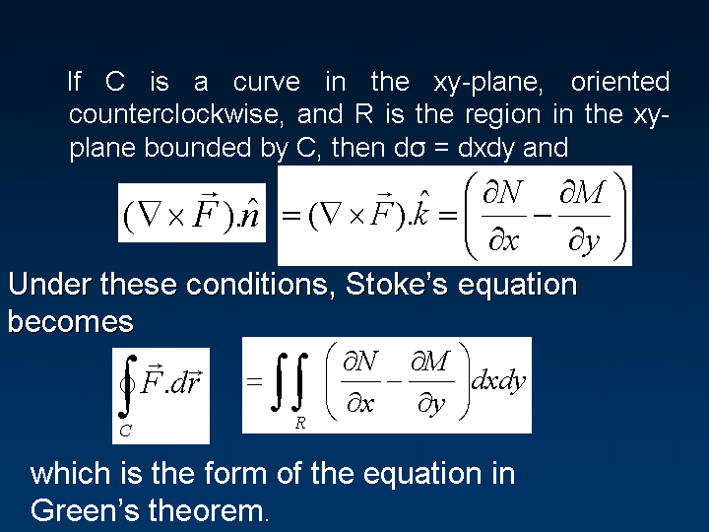

Slide 27
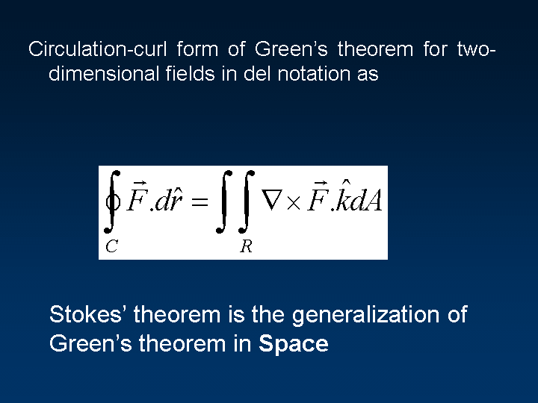

Slide 28
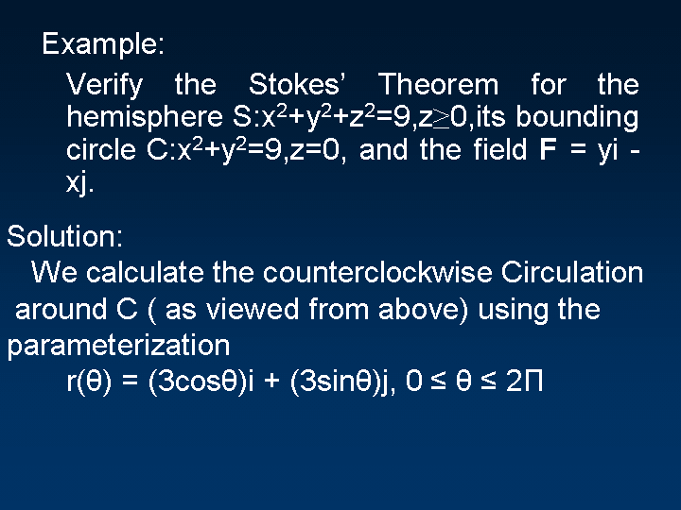

Slide 29
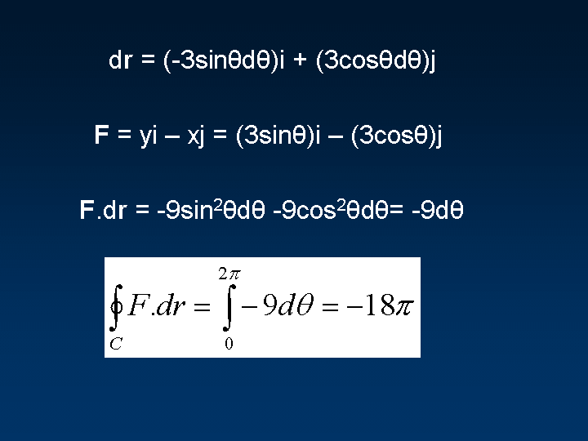

Slide 30
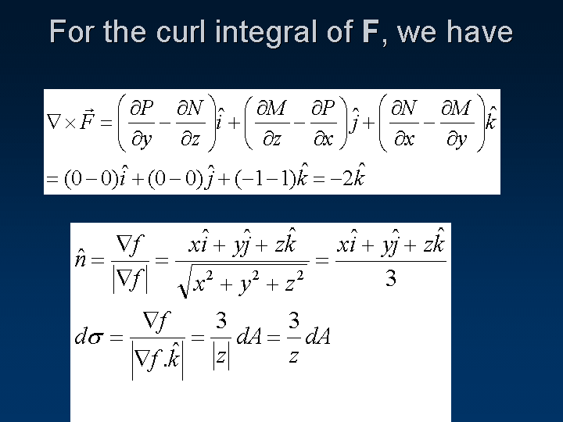

Slide 31
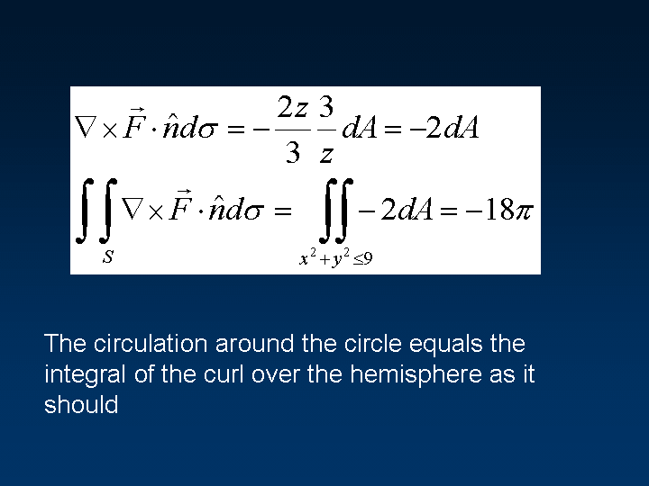

Slide 32
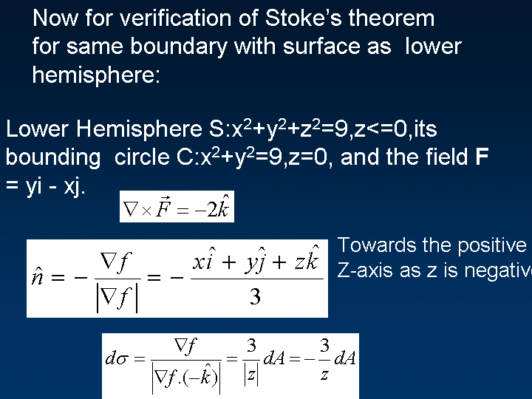

Slide 33
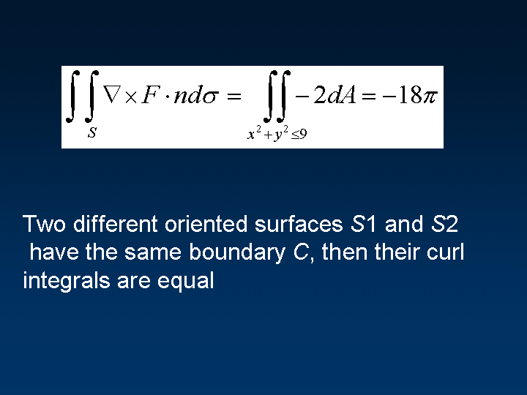

Slide 34

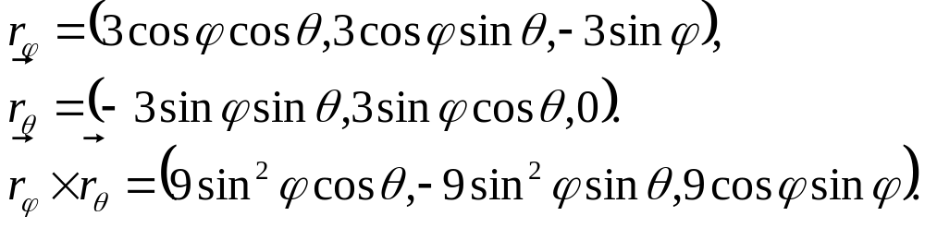
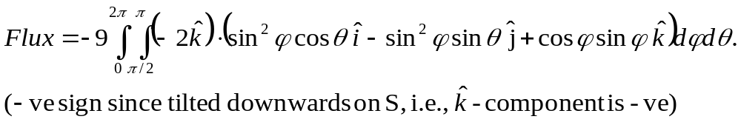
We have used level surface form of surface integral.
In stead, we could have used parametrized form.

Slide 35
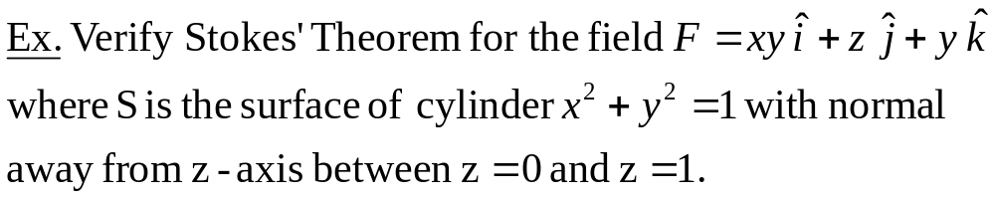

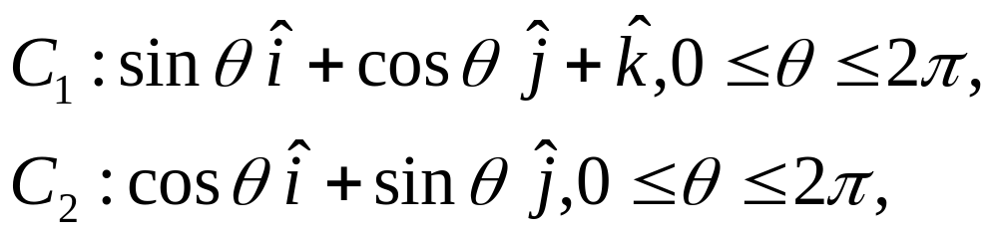
z
Boundary C has two pieces :
C₁ : circle in z=1 plane traced
clockwise
C₂ : circle in z=0 plane traced
counterclockwise
y
x

Slide 36
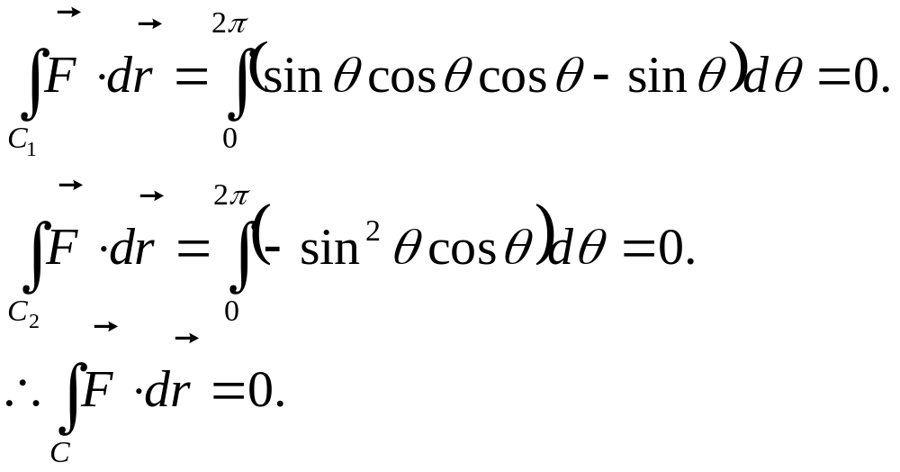

Slide 37
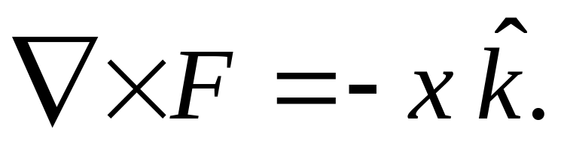
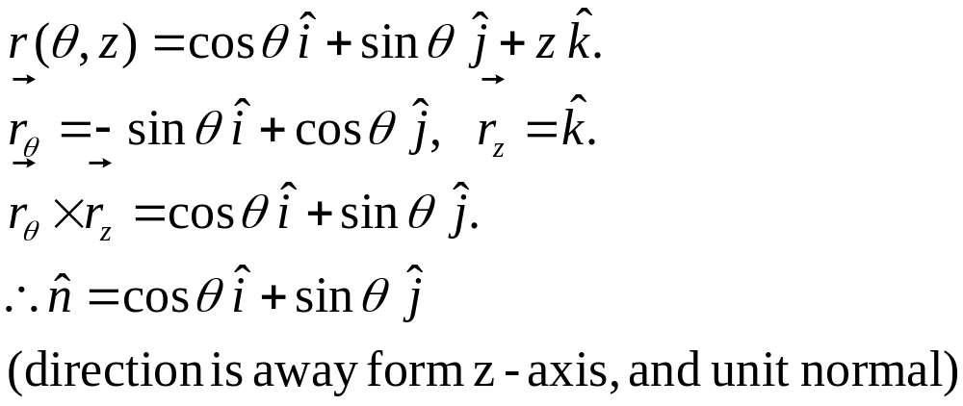

Slide 38
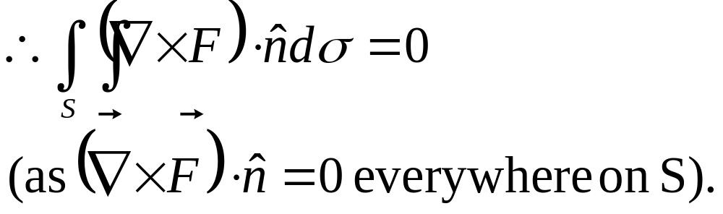

Slide 39
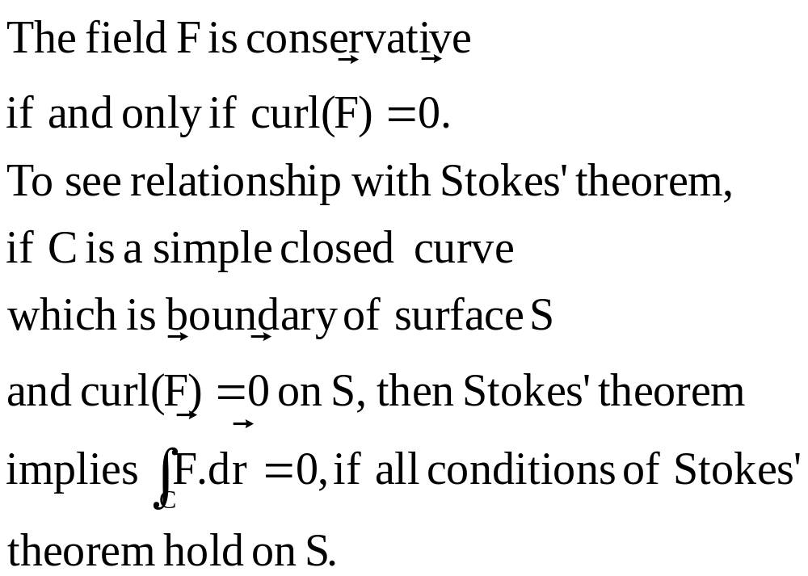

Slide 40
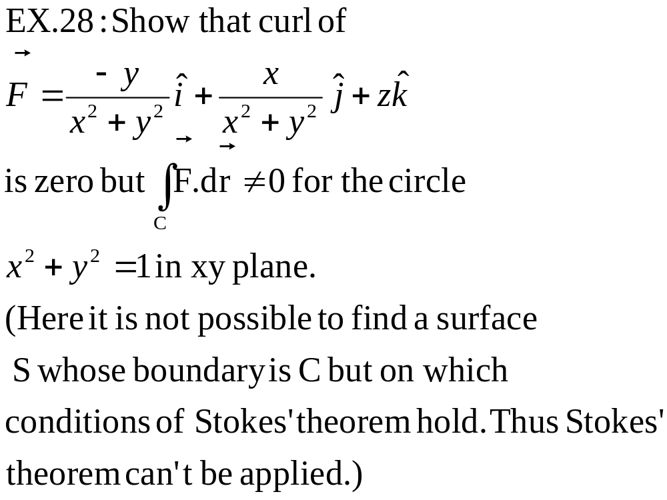

Slide 41
A region D is simply connected if any closed curve in D can be continuously shrunk to a point by remaining in D.
Test for conservativeness holds only for simply connected regions, as seen in Ex. 26.

Slide 42
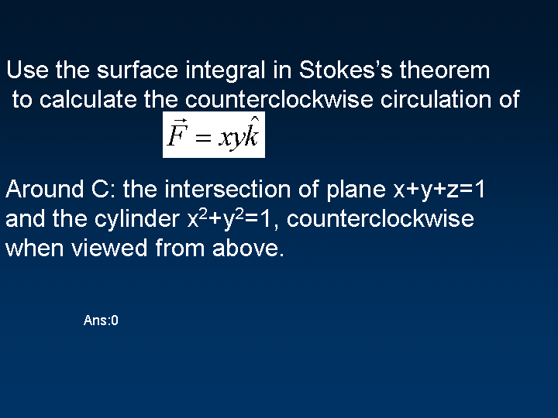

Slide 43
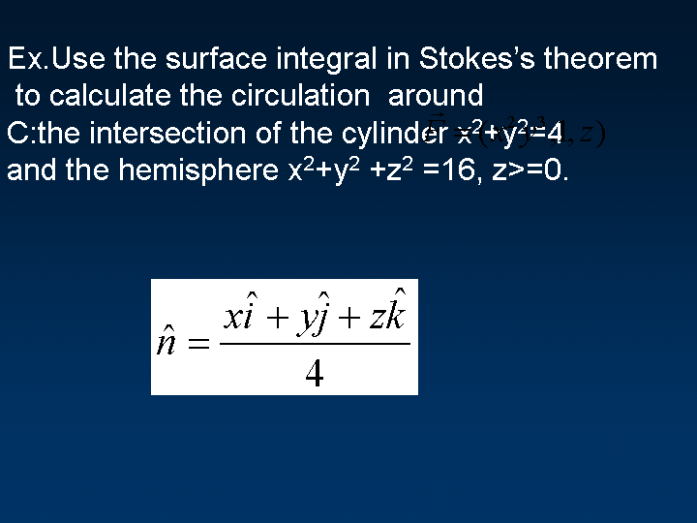

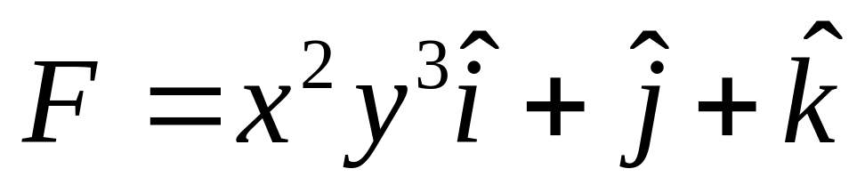
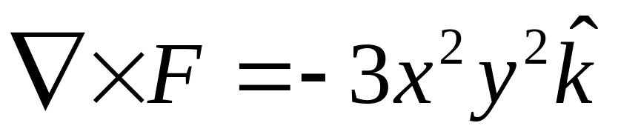

Slide 44
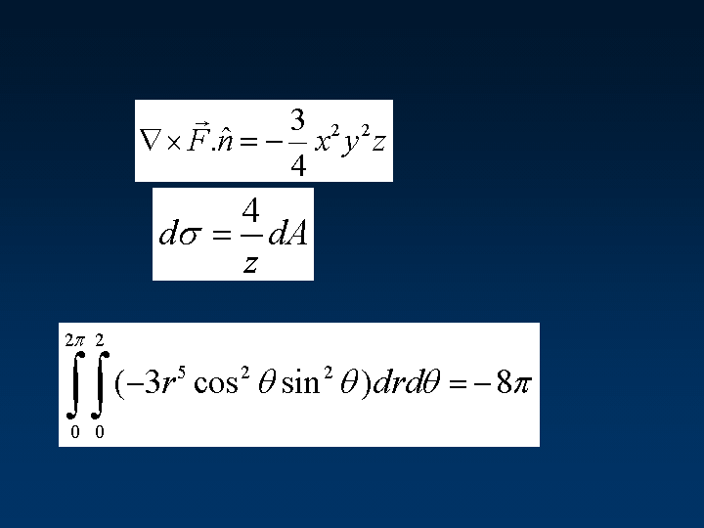

Slide 45
Piecewise smooth surfaces
If a surface S can be decomposed into finite union of non-overlapping smooth surfaces (e.g. union of plane regions is a polyhedral surface), then Stokes’ theorem also holds on S. The surface integral of curl(F).n on S is sum of surface integrals on its smooth pieces.

Slide 46
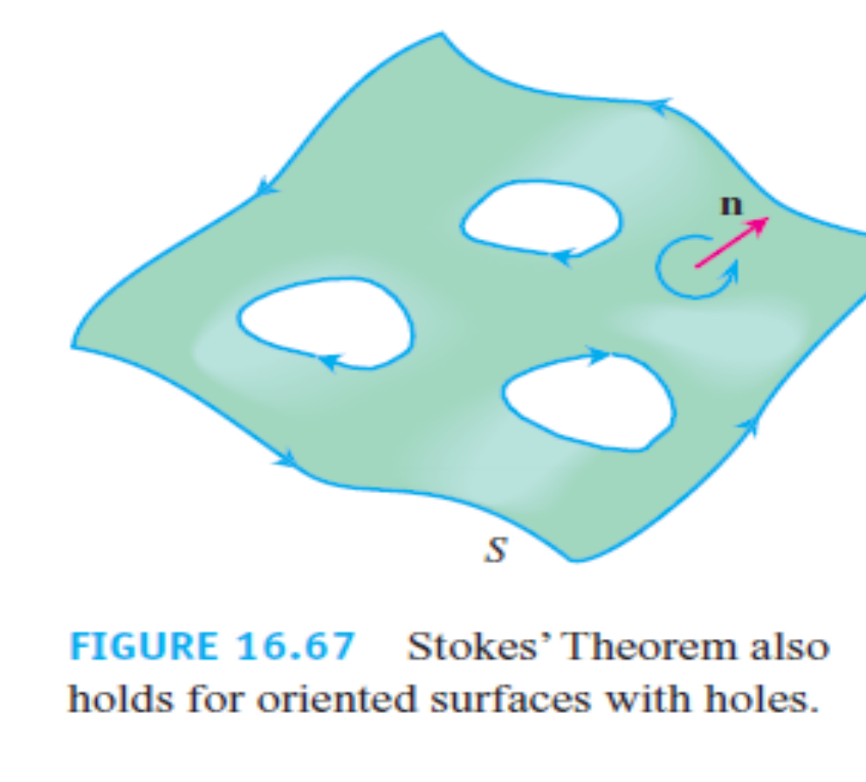
Surfaces with holes
If a surface has holes as in the figure, orientation of outer boundary must be anticlockwise wrt normal of the surface and for inner boundaries, it should be clockwise.

Slide 47
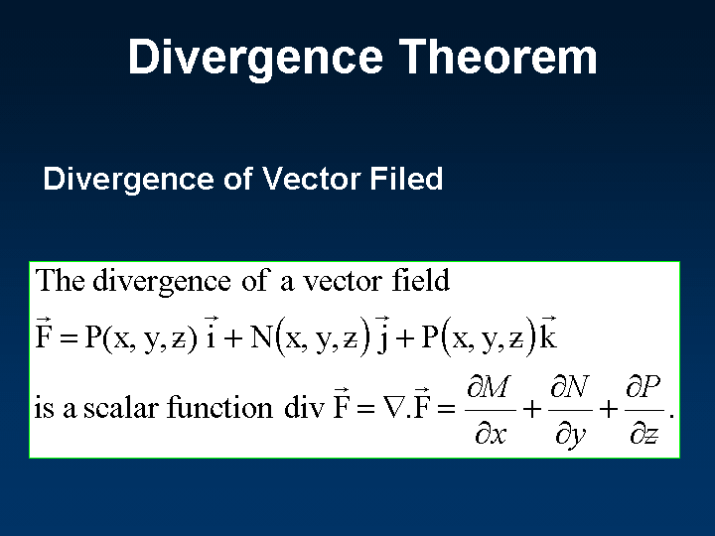

Slide 48

Assumption :Usual conditions that M, N, P are continuous and have continuous first partials are satisfied by F.

Slide 49


Slide 50


Slide 51


Slide 52


Slide 53


Slide 54


Slide 55
Some identities and consequences
Curl(grad(f) = 0 for any scalar field f.
Thus Stokes’ theorem says if F = grad(f) then ∫_{C}F.dr=0 for closed curves C which bound a surface S on which conditions of Stokes’ theorem hold.
Div(curl(F))=0 for any vector field F.(verify)
Thus Divergence theorem says for fields curl(F) flux across closed surface is 0.

Slide 56
Divergence Theorem for other regions
If a region can be partitioned into regions each of which is inside of a closed surface, then divergence theorem is valid. The boundary has to be taken with appropriate orientation.

Slide 57
Hollow sphere
If the region is between two concentric spheres, then the theorem can be applied with outward normal for outer sphere and inward normal for the inner sphere.

Slide 58


Slide 59


P 982, Ex. 28
A real valued function f(x,y,z) is called harmonic function on a region D if at all points of D,

Slide 60

Exercise

Slide 61
All the best!

